Slide 1



Hospital ER Dashboard Ratnesh Satyarthi
View in Power BI
Last data refresh:
1/31/2025 11:10:30 AM UTC
Downloaded at:
1/31/2025 11:20:58 AM UTC

Slide 2
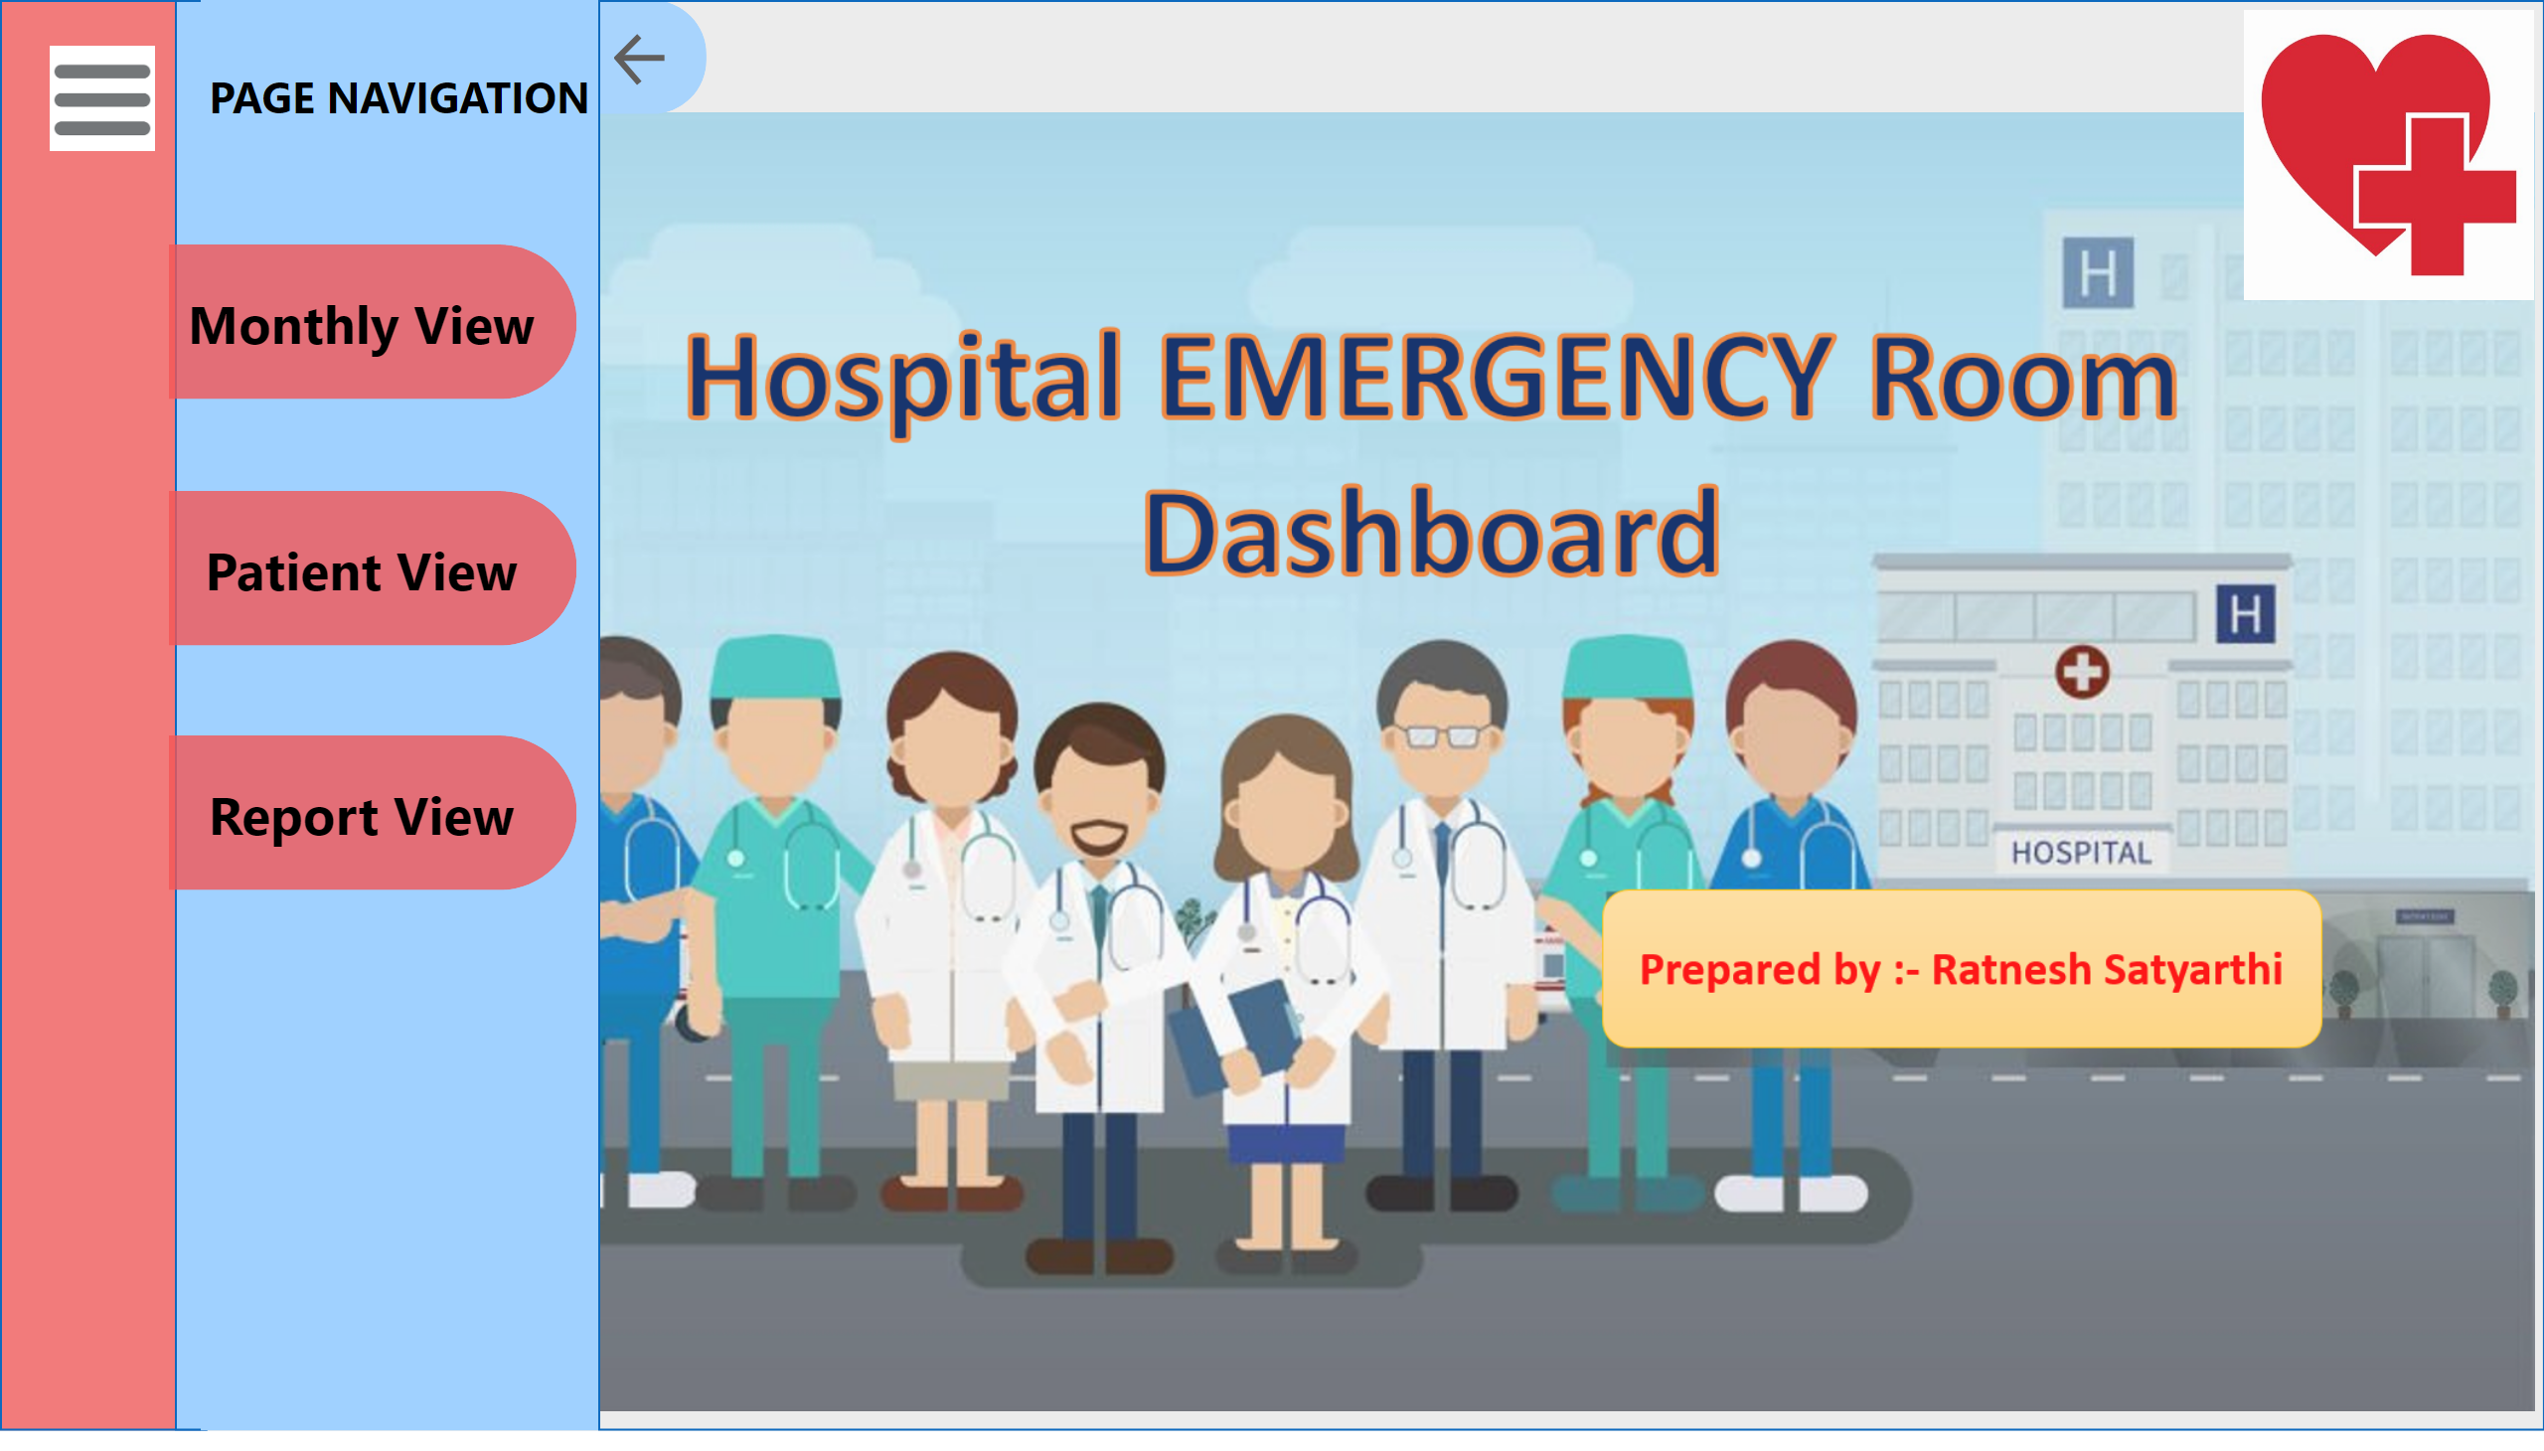
Landing Page
Notes:
Menu
No alt text provided
Monthly view
No alt text provided
Patient view
No alt text provided
Report view
No alt text provided
PAGE NAVIGATION
No alt text provided
Right Margin
No alt text provided
Close Button
No alt text provided
Close cover button
No alt text provided
Arrow shape
No alt text provided
Left Margin
No alt text provided
image
No alt text provided
image
No alt text provided

Slide 3
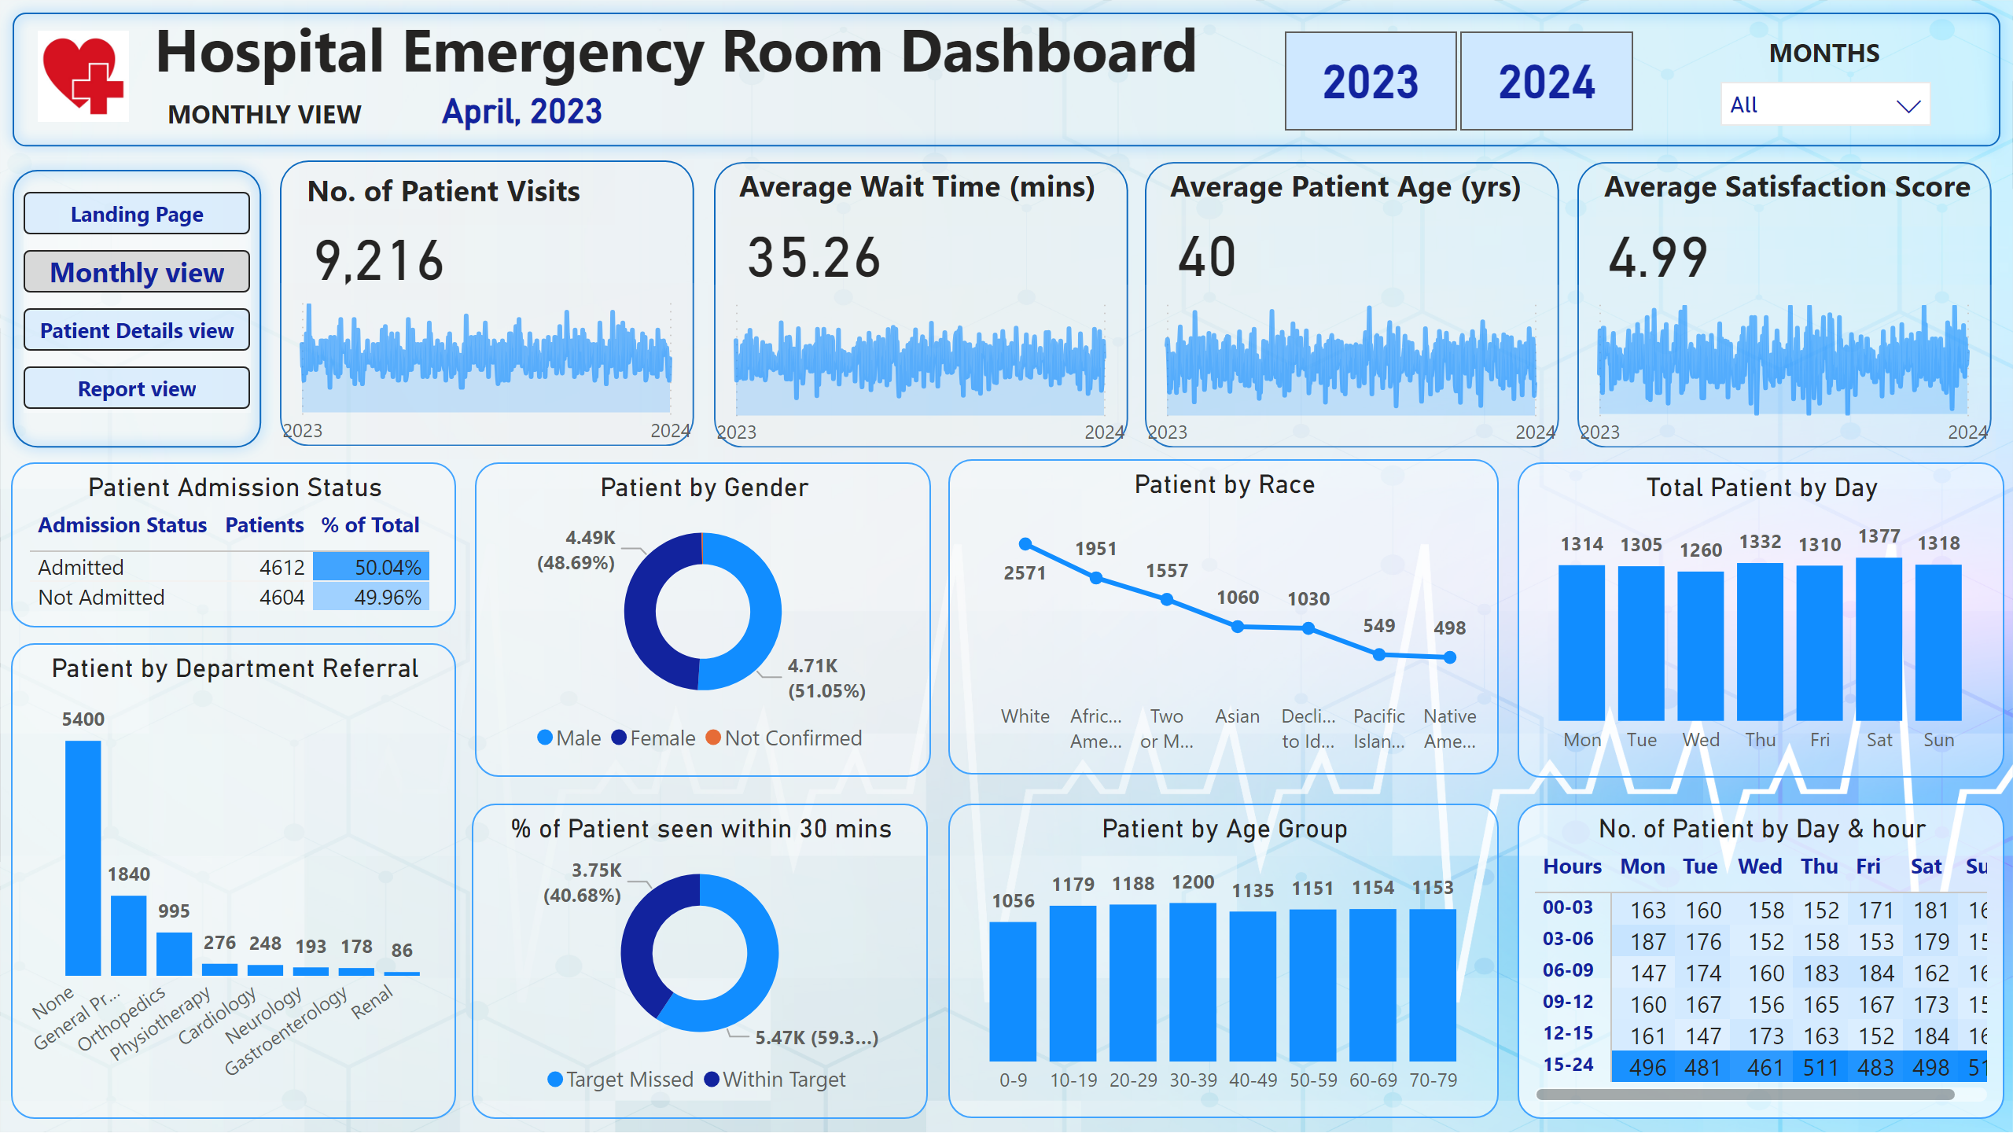
Monthly view
Notes:
textbox
No alt text provided
textbox
No alt text provided
card
No alt text provided
textbox
No alt text provided
slicer
No alt text provided
slicer
No alt text provided
shape
No alt text provided
textbox
No alt text provided
Patient Visits
No alt text provided
No. of Patient by Date
No alt text provided
shape
No alt text provided
textbox
No alt text provided
Patient Visits
No alt text provided
No. of Patient by Date
No alt text provided
shape
No alt text provided
textbox
No alt text provided
Patient Visits
No alt text provided
No. of Patient by Date
No alt text provided
shape
No alt text provided
textbox
No alt text provided
Patient Visits
No alt text provided
No. of Patient by Date
No alt text provided
shape
No alt text provided
Patient Admission Status
No alt text provided
Patient by Department Referral
No alt text provided
Patient by Race
No alt text provided
Patient by Gender
No alt text provided
Patient by Age Group
No alt text provided
% of Patient seen within 30 mins
No alt text provided
No. of Patient by Day & hour
No alt text provided
Total Patient by Day
No alt text provided
image
No alt text provided
pageNavigator
No alt text provided
shape
No alt text provided

Slide 4
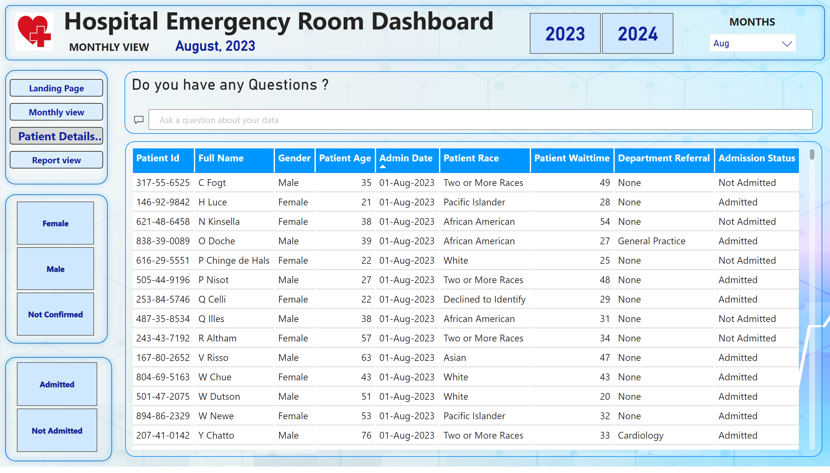
Patient Details view
Notes:
shape
No alt text provided
textbox
No alt text provided
textbox
No alt text provided
card
No alt text provided
textbox
No alt text provided
slicer
No alt text provided
slicer
No alt text provided
shape
No alt text provided
image
No alt text provided
tableEx
No alt text provided
slicer
No alt text provided
slicer
No alt text provided
pageNavigator
No alt text provided
shape
No alt text provided
shape
No alt text provided
Do you have any Questions ?
No alt text provided

Slide 5
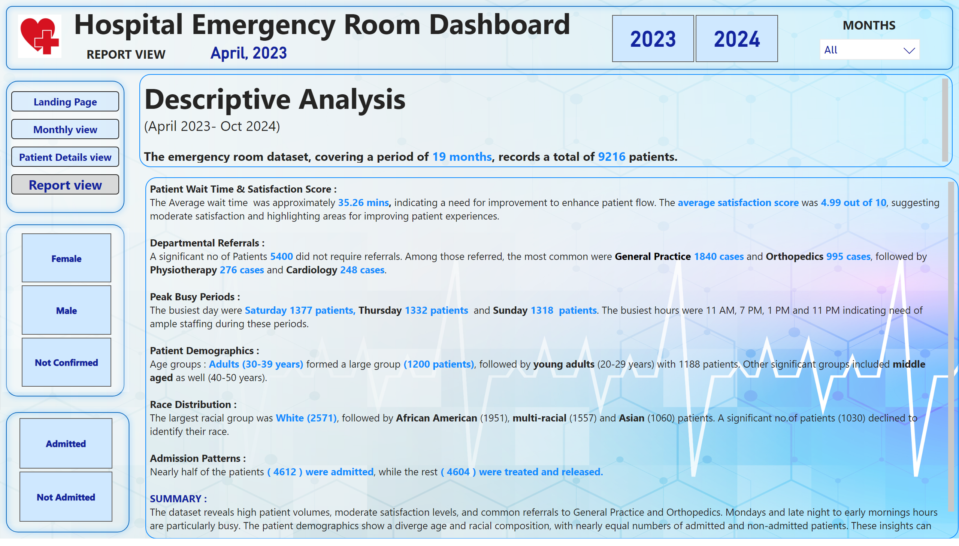
Report view
Notes:
shape
No alt text provided
textbox
No alt text provided
textbox
No alt text provided
card
No alt text provided
textbox
No alt text provided
slicer
No alt text provided
slicer
No alt text provided
shape
No alt text provided
image
No alt text provided
slicer
No alt text provided
pageNavigator
No alt text provided
shape
No alt text provided
shape
No alt text provided
textbox
No alt text provided
slicer
No alt text provided
textbox
No alt text provided

